Slide 1
BANK CUSTOMERS ANALYSES
This project is to visualize for a bank that has branches in 3 countries:
France,Germany,Spain. We want to know the possibilities to why some customers left the bank.

Slide 2
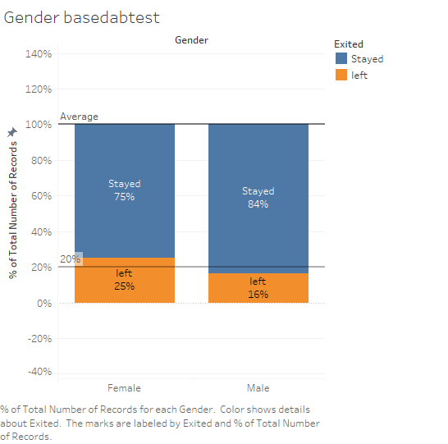
GENDER BASED
This slide visualizes the possibilities of customers leaving based on their gender by looking at the percentages.
75% of Female Customers stayed.
25% of Female Customers left.
Customers that left are above the average of 20% thus further investigations should be made into the reasons to which more Female customers left.
84% of Male customers stayed.
16% of Male Customers left.
Female Male

Slide 3
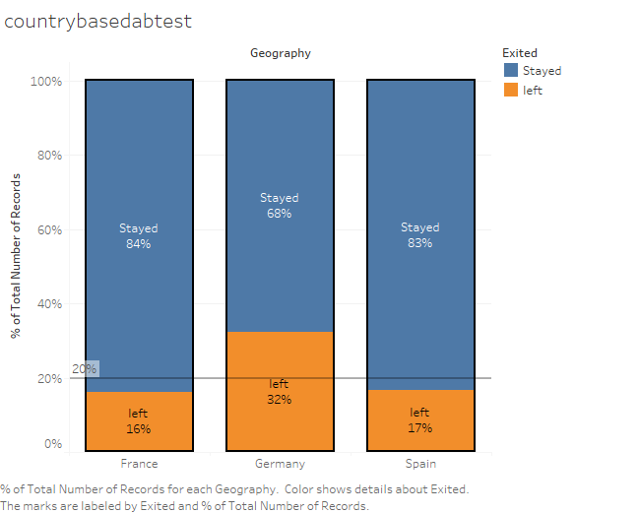
COUNTRY BASED
This slide visualizes the possibilities of customers leaving in their respective countries.
France
84% Customers from France stayed.
16% of Customers left.
Customers that left are below the average of 20%.
Spain
83% Customers from Spain stayed.
17% Customers from spain left.
Customers that left are below the average of 20% of the total customers.
Germany
68% Customers from Germany stayed.
32% Customers left.
Customers that left are above the average of 20% thus a cause for concern and further investigations.

Slide 4
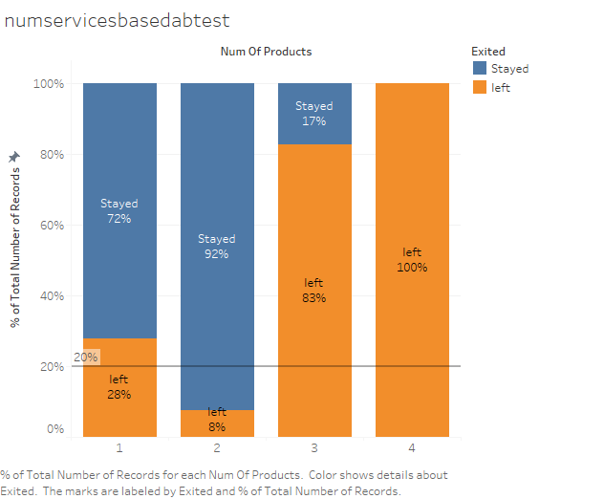
SERVICES BASED
This slide visualizes the possibilities of customers leaving based on the number of services they are signed on with the bank.
28% of Customers with 1 service left.
8% of Customers with 2 services left.
83% of Customers with 3 services left.
100% of Customers with 4 services left.

Slide 5
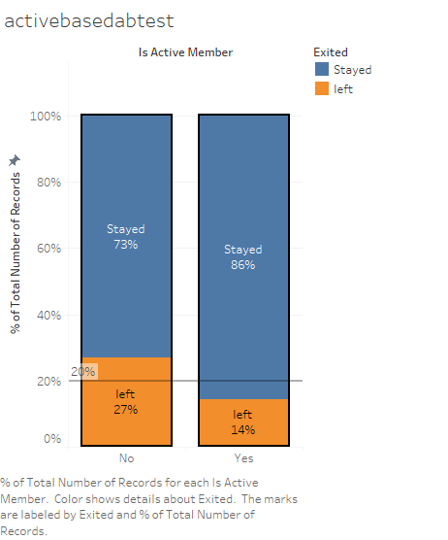
ACCOUNT STATUS BASED
This slide visualizes the possibilities of customers leaving based on the status of their account for the last 6 months.
27% of customers with account status as inactive left
14% of customers with account as active left.
Conclusion is when customer’s account become inactive for over 6months they are more likely to leave.

